Slide 1






Advanced EF Relations
Working with Fluent API
Inheritance Strategies
Advanced
Relations
SoftUni Team
Technical Trainers
Software University
http://softuni.bg

Slide 2

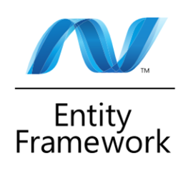
Table of Contents
Fluent API (Model Builder)
Joining and Grouping Tables
View Models
Inheritance Strategies

Slide 3
Questions
sli.do #Entity

Slide 4

Fluent API
Working with Model Builder

Slide 5
Fluent API
Code First maps your POCO classes to tables using a set of conventions
E.g. property named "Id" maps to the Primary Key
Can be customized using annotations and the Fluent API
Fluent API (Model Builder) allows full control over DB mappings
Custom names of objects (columns, tables, etc.) in the DB
Validation and data types
Fix complicated entity relationships

Slide 6
Initialize Fluent API
Custom mappings are placed inside the OnModelCreating method of the context
protected override void
OnModelCreating(DbModelBuilder modelBuilder)
{
modelBuilder.Entity<Student>().HasKey(s => s.StudentKey);
base.OnModelCreating(modelBuilder);
}
Resume default behavior

Slide 7
Rename DB Objects
Custom Table name
Custom Column name
Optional schema name
modelBuilder.Entity<Order>().ToTable("OrderRef", "Admin");
modelBuilder.Entity<Student>()
.Property(s => s.Name)
.HasColumnName("StudentName")
.HasColumnType("varchar");
Optional data type

Slide 8
Column Attributes
Explicitly set Primary Key
Other column attributes
modelBuilder.Entity<Student>().HasKey("StudentKey");
modelBuilder.Entity<Person>().Property(p => p.FirstName)
.IsOptional()
.IsRequired()
.IsFixedLength()
.HasMaxLength()

Slide 9
Entity Relationships
One-to-Zero-or-One
One-to-One
Address contains FK to Student
modelBuilder.Entity<Address>()
.HasRequired(a => a.Student)
.WithOptional(s => s.Address);
modelBuilder.Entity<Address>()
.HasRequired(a => a.Student)
.WithRequiredDependent(s => s.Address);

Slide 10
Entity Relationships (2)
One-to-Many
One-to-Many with custom FK name
modelBuilder.Entity<Comment>()
.HasRequired(c => c.Post)
.WithMany(p => p.Comments)
modelBuilder.Entity<Comment>()
.HasRequired(c => c.Post)
.WithMany(p => p.Comments)
.HasForeignKey(c => c.PostKey);

Slide 11
Entity Relationships (3)
Many-to-Many
Many-to-Many with custom FK names
modelBuilder.Entity<Student>()
.HasMany(s => s.Courses)
.WithMany(c => c.Students)
… .Map(cs =>
{
cs.ToTable("StudentCourses");
cs.MapLeftKey("StudentKey");
cs.MapRightKey("CourseRefId");
});

Slide 12
Other Options
Do not include property in DB
Disabling cascade delete
If a FK property is non-nullable, cascade delete is on by default
modelBuilder.Entity<Department>().Ignore(d => d.Budget);
modelBuilder.Entity<Course>()
.HasRequired(t => t.Department)
.WithMany(t => t.Courses)
.HasForeignKey(d => d.DepartmentID)
.WillCascadeOnDelete(false);

Slide 13
Specialized Configuration Classes
Mappings can be placed in entity-specific classes
Include in OnModelCreating:
public class StudentConfiguration
: EntityTypeConfiguration<Student>
{
public StudentConfiguration()
{
this.HasKey(s => s.StudentKey);
}
}
Specify target model
No need to reference modelBuilder
modelBuilder.Configurations.Add(new StudentConfiguration());

Slide 14
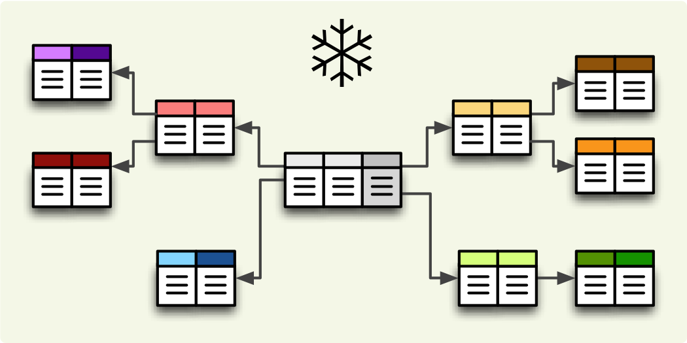
Filtering and Aggregating Tables
Select, Join and Group Data Using LINQ

Slide 15
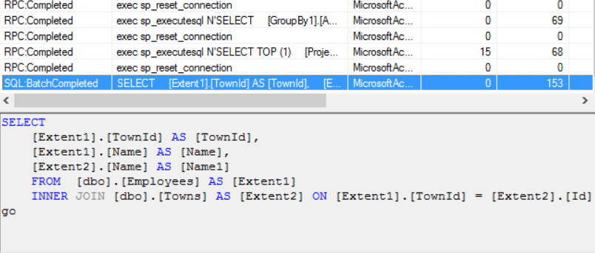
Why use select
Limit network traffic by reducing the queried columns
Syntax:
var employeesWithTown = context
.Employees
.Select(employee => new
{
EmployeeName = employee.Name,
TownName = employee.Town.Name
});

Slide 16
Why not to use select
Data that is selected is not of the initial entity type, but of an anonymous type that is generated runtime (a bit more expensive)
Data cannot be modified (updated, deleted), when selected, because we are not working with the actual object, but with a read-only “copy” of it

Slide 17
Joining Tables in EF
Join tables in EF with LINQ / extension methods on IEnumerable<T> (like when joining collections)
var employees =
from employee
in softUniEntities.Employees
join department
in softUniEntities.Departments
on employee.EmployeeID
equals department.DepartmentID
select new {
Employee = employee.FirstName,
JobTitle = employee.JobTitle,
Department = department.Name
};
var employees =
softUniEntities.Employees.Join(
softUniEntities.Departments,
(e => e.DepartmentID),
(d => d.DepartmentID),
(e, d) => new {
Employee = e.FirstName,
JobTitle = e.JobTitle,
Department = d.Name
}
);

Slide 18
Grouping Tables in EF
Grouping also can be done by LINQ
The same way as with collections in LINQ
Grouping with LINQ:
Grouping with extension methods:
var groupedEmployees =
from employee in softUniEntities.Employees
group employee by employee.JobTitle;
var groupedCustomers = softUniEntities.Employees
.GroupBy(employee => employee.JobTitle);

Slide 19
ViewModels
Select, Group, Join can work with custom classes
Allows you to pass them to methods and use them as return type
Requires some extra code (class definition)
Sample ViewModel:
public class UserInfoView
{
public string Alias { get; set; }
public byte[] Avatar { get; set; }
}

Slide 20
View Models (2)
Assign the fields as you would with an anonymous object:
The new type can be used in a method signature:
var currentUser = context.Users
.Find(8)
.Select(u => new UserInfoView
{
Alias = u.FirstName + " " + u.LastName,
Avatar = u.Avatar
})
.SingleOrDefault();
public static UserInfoView GetUserInfo(int Id) { … }

Slide 21
Inheritance Strategies
Vehicle
Car
Truck
Electric
Petrol
Mapping Class Hierarchies to DB Objects

Slide 22
Object Inheritance
Extending system classes
Extending C# classes
Extending Domain Models (POCOs)

Slide 23
Table per Hierarchy (TPH)
One table for all classes in the chain
Differentiated by Discriminator column
modelBuilder.Entity<Vehicle>()
.Map<Car>(m => m
.Requires(“Discriminator")
.HasValue(“Car”)
)
.Map<Truck>(m => m
.Requires("Discriminator")
.HasValue(“Truck”)
);

Slide 24
Table per Type (TPT)
One table for each class, containing only the needed properties
Parent-class table contains all common properties
Child-class tables have a shared PK with parent-class table
modelBuilder.Entity<ChildClassOne>()
.ToTable(“TableNameOfChildClassOne”);
modelBuilder.Entity<ChildClassTwo>()
.ToTable(“TableNameOfChildClassTwo”);

Slide 25
Table per Concrete Type (TPC)
Each entity has it's own table with no obvious relation
The base domain model must be modified:
modelBuilder.Entity<Car>().Map(m =>
{
m.MapInheritedProperties();
m.ToTable("Car");
});
modelBuilder.Entity<ParentClass>()
.Property(p => p.”Id”)
.HasDatabaseGenerationOption(DatabaseGenerationOption.None);

Slide 26

Summary
The Fluent API gives us full control over Entity Framework object mappings
Information overhead can be limited by selecting only the needed properties
ModelViews can be used to move aggregated data between methods
Different Inheritance Strategies can be used for optimal DB performance

Slide 27








Entity Framework Relations
https://softuni.bg/courses/

Slide 28
License
This course (slides, examples, demos, videos, homework, etc.) is licensed under the "Creative Commons Attribution-NonCommercial-ShareAlike 4.0 International" license
Attribution: this work may contain portions from
"Databases" course by Telerik Academy under CC-BY-NC-SA license

Slide 29




Free Trainings @ Software University
Software University Foundation – softuni.org
Software University – High-Quality Education, Profession and Job for Software Developers
softuni.bg
Software University @ Facebook
facebook.com/SoftwareUniversity
Software University Forums
forum.softuni.bg

